Slide 1

Emerging Technologies
Session #05: An introduction to NodeJS
IBM Bluemix
The Digital Innovation Platform
Sylvain-Roch WILBERT
s_wilbert@fr.ibm.com
Université Paris - Dauphine

Slide 2
Exercize 03 - NodeJS basics My first app
Directory : 02-firstapp

Slide 3
Exercize 03 - NodeJS basics Our requirements
Presentation :
Have a page allowing to add
A name (String)
A profile (Text)
Application logic:
Be able to store the content filled by the user
Displayed an error when an incorrect page is requested
Data storage:
Data are stored in memory ( session)
No persistence, data are volatile

Slide 4
Exercize 03 - NodeJS basics First level of analysis
Routes to create
GET: The page is displayed
POST: The content is sent to the server for storage
Template
1 page to enter 2 fields
Javascript
A session to store the content (volatile)
The analysis of the page sent to retrieve the fields
A function to support the error management.

Slide 5
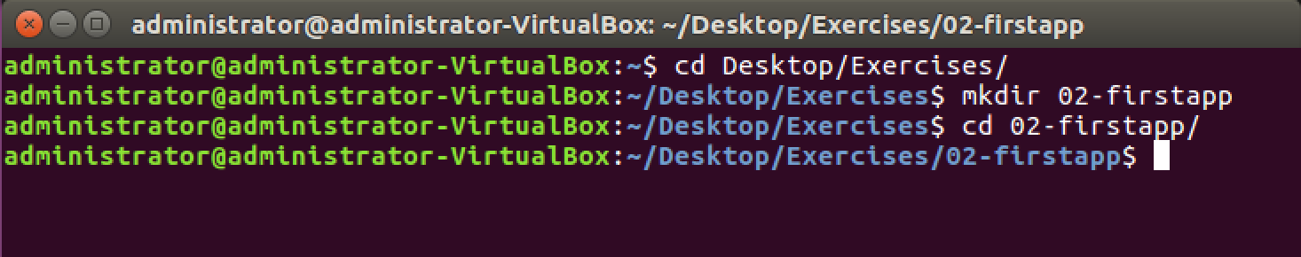

Slide 6
Exercize 03 - NodeJS basics My first app - Create the package.json file
Create the package.json by answering questions:
From the directory, in a terminal: npm init

Slide 7
Exercize 03 - NodeJS basics My first app- add the required library
Add the required libraries from a terminal by using the
npm install LIBRARYNAME --save
node_module directory will be created, and libraries downloaded
Packages.json will be updated
Libraries to install
body-parser : Body response analysis
cookie-parser : Cookie content analysis
ejs: page templating
express: common library
express-session: session management

Slide 8
Exercize 03 - NodeJS basics My first app
Package.json is updated

Slide 9
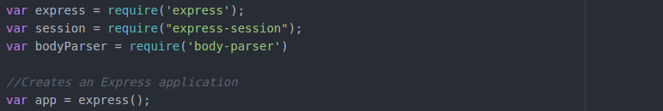
Exercize 03 - NodeJS basics The code
In the app.js
Initialize the required variable base on the libraries, and an app variable
The application shall parse the URL (GET), parse the body (POST) and rely on a session (in-memory persistance)

Slide 10
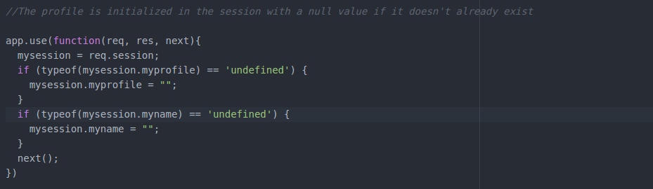
Exercize 03 - NodeJS basics The code
The session is initialized

Slide 11
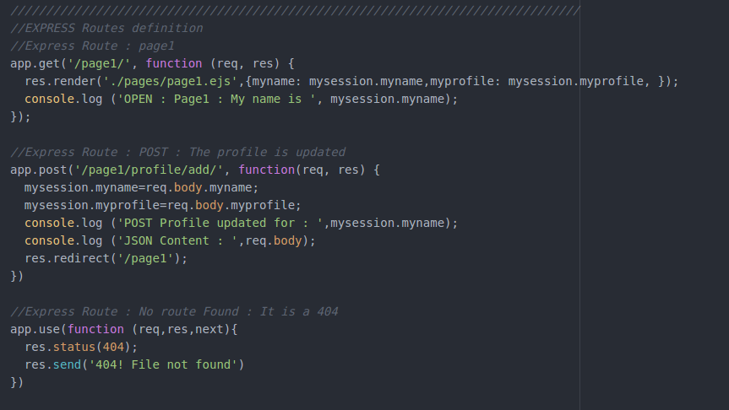
Routes
3 routes to different pages
Default page (GET)
« Add a profile »(POST)
« File not found » page (error 404)

Slide 12
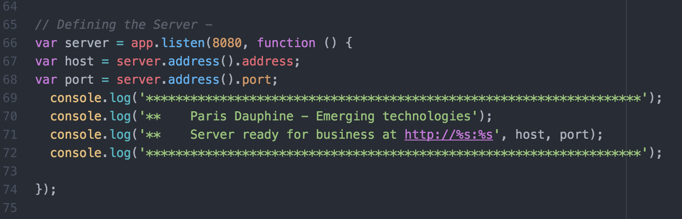
Exercize 03 - NodeJS basics The code
Launch the server

Slide 13
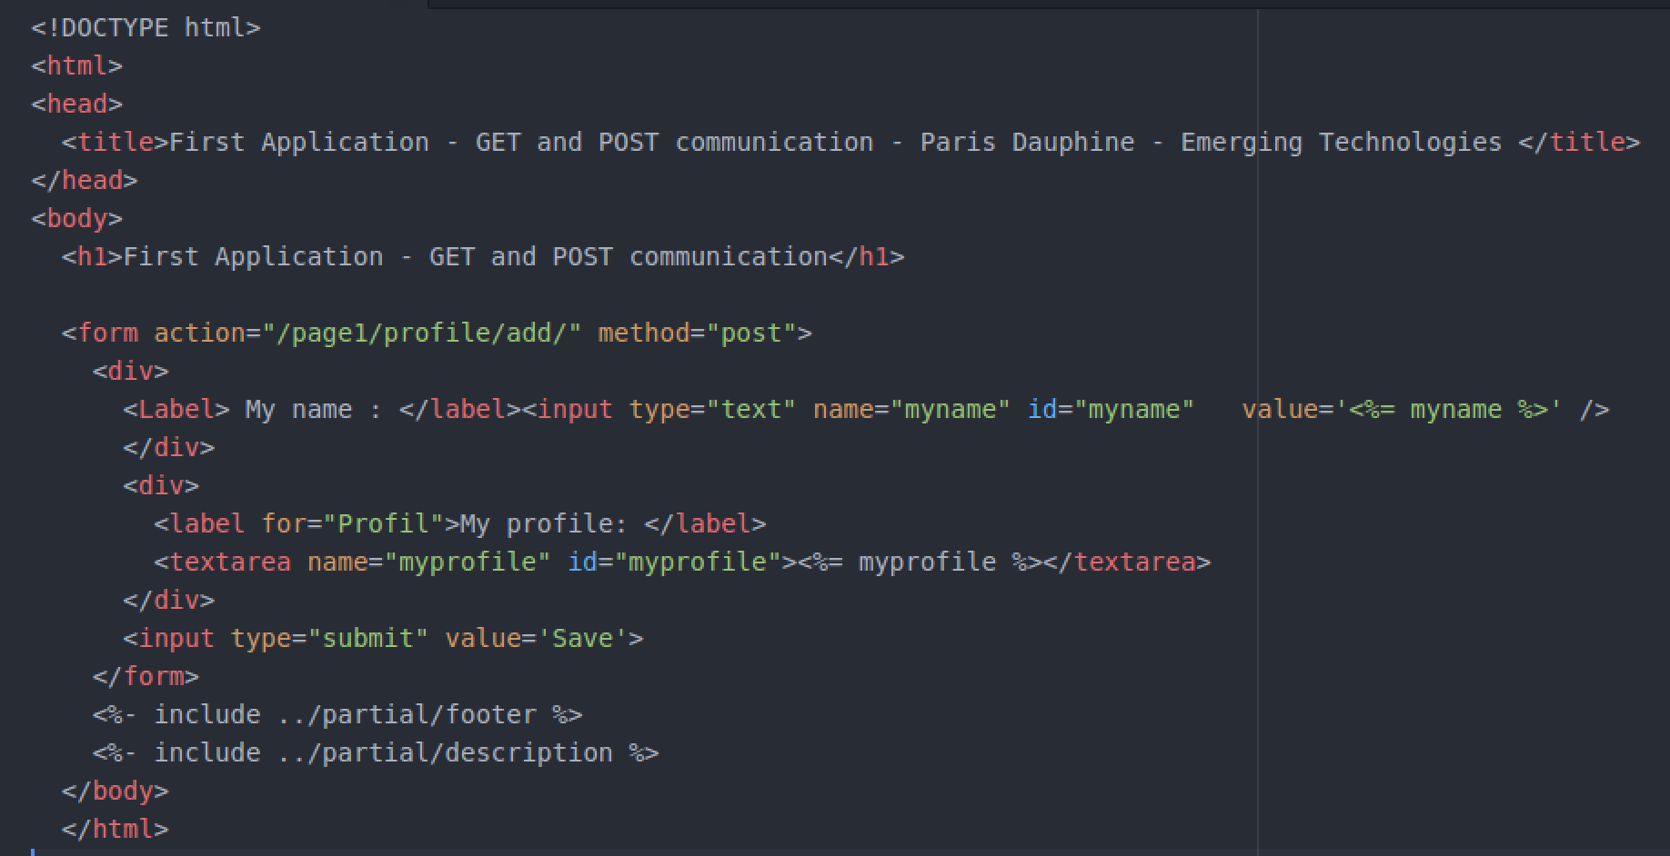
Exercize 03 - NodeJS basics The EJS template to render the screen
Route to add a profile
Variable sent by the js code
optional

Slide 14
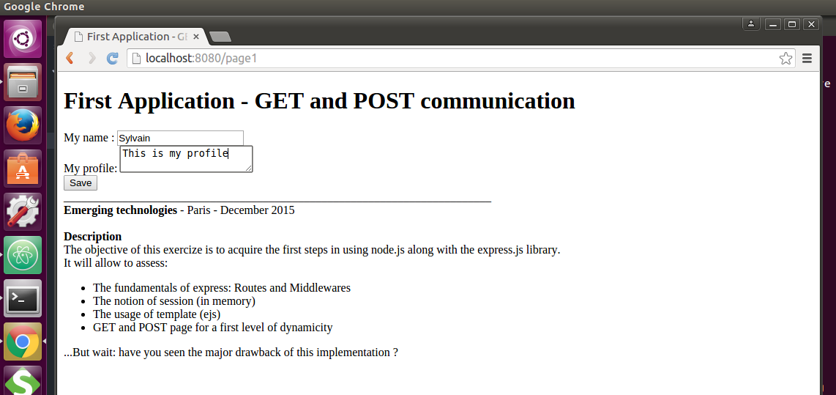
Exercize 03 - NodeJS basics The result

Slide 15
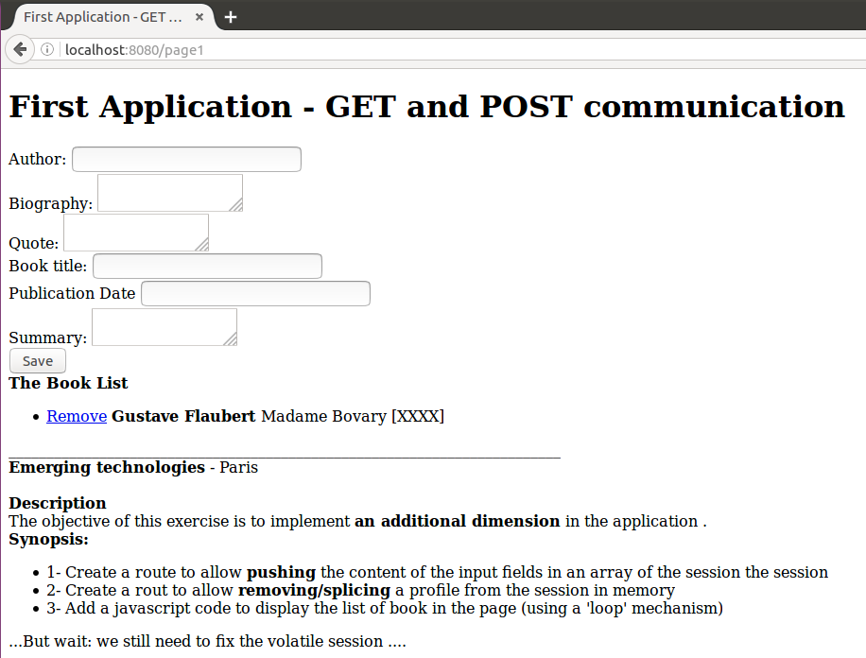
Optional Exercize playing with session
Values can be removed from the a list in the session
Values can be managed as a list in the session

